Slide 1
Blind estimation of acoustic transfer functions (ATFs) and dereverberation based on convolutive transfer functions (CTFs) Date：2022. 11. 15
Telecom Electroacoustics Audio(TEA) Lab
Presenter:
Anchi Yuan
Notes:
Hello everyone
I’m today’s presenter siang. I’m going to share some of my present work in source separation problem. My topic is comparative studies of source separation using semi-blind and blind source separation approaches.

Slide 2
Outline
MTF model using least-square sense (tfestimate)
CTF model using Wiener filter
Simulation setting
Simulation result
Conclusion
Future work

Slide 3
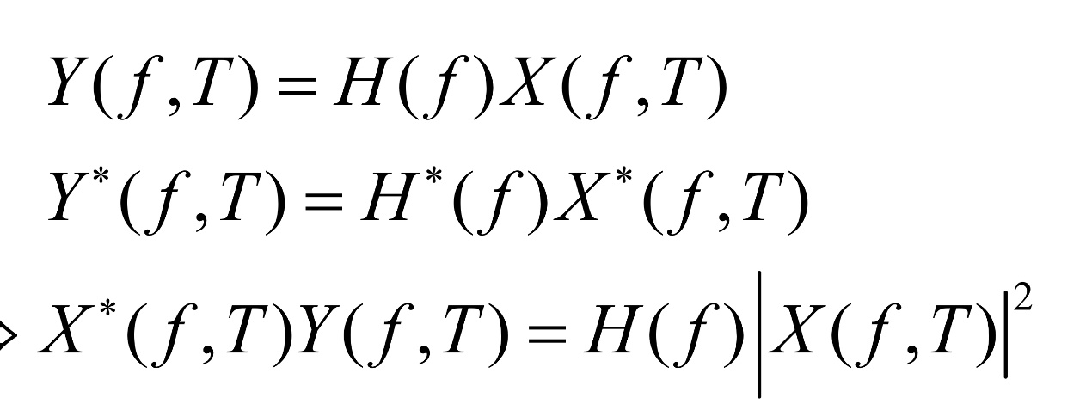
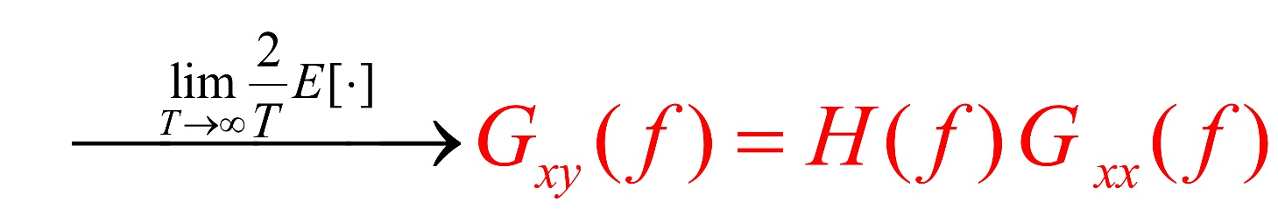
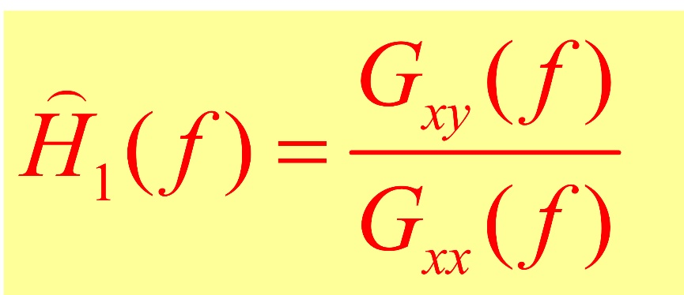
MTF model using least-square sense (tfestimate)

Slide 4
CTF model using Wiener filter

Slide 5
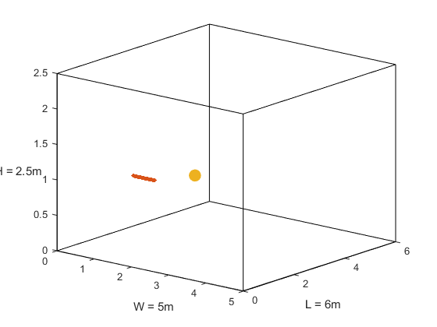

Simulation setting
Uniform linear array (ULA)
Number of microphones = 30
Spacing = 0.02m (2cm)
Aperture = (30-1)*0.02 = 0.58 m
Room size = 5m $×$6m $×$2.5m
Sampling frequency = 16kHz
Reverberation time T₆₀ =0.6s
First mic (1, 1.5, 1)
Source (2, 2.6, 1)
mic spacing = 0.02m
z
y
x

Slide 6
Simulation result
ME = 0.1201
ME = 1.7260

Slide 7
Conclusion
When RIR needed to recover is too long, CTF method will outperform MTF method a lot.

Slide 8
Future work
PME proposal
Experiment

Slide 9


